Slide 1
Moon and stars
On a clear night stars can be seen in the sky.
Often the Moon is seen as well.

Slide 2
Moon and stars
1a What does the Moon do at night?
A Stays still
B
C
D

Slide 3
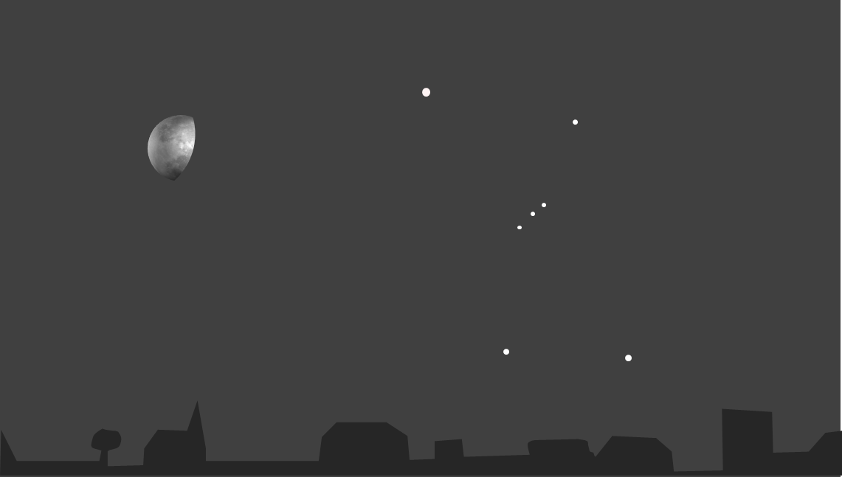
Moon and stars
1b Why do you think the Moon does this?
The Moon is always there and can be seen when it is dark
The Earth spins on its axis once each day
The Moon goes round the Earth once each day
The Moon swaps places with the Sun

Slide 4
Title
2a What do the stars do at night?
A Stay still
B
Some stars move in each of these three ways
(A, B and C)
C
D

Slide 5
Moon and stars
2b Why do you think the stars do this?
The Earth spins on its axis once each day
The stars swap places with the Sun
The stars go round the Earth once each day
The stars are always there and can be seen when it is dark

Slide 6
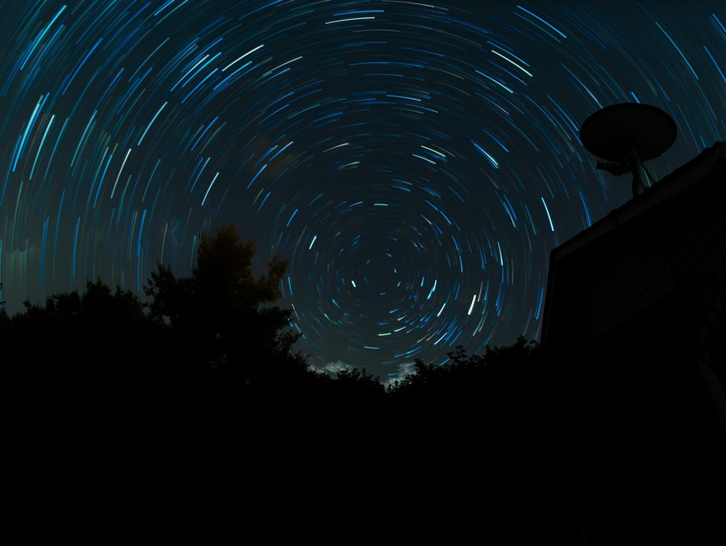
Time-lapse photograph showing the movement of stars
Notes:
Photo by Nathan Anderson on Unsplash

